Slide 1
CPSC 481 Presentation 2
Lucy OuYang, Ekhonmu Egbase, Nami Marwal, Esther Thompson

Slide 2
Recap
Who Are You? GlobeTrekker, a travel company based in Calgary.
Who Are You Working For? Tourists who need digital tools to easily explore Calgary and plan their trips.
Goal of the New System: Develop a desktop application that simplifies the itinerary-building process for tourists, helping them book local events and navigate attractions.
Future Vision: In the future, the app will feature a premium subscription service offering personalized, made-for-you itineraries based on user preferences. For now, the focus is on attracting tourists to Calgary and guiding them through the process of building their own itineraries.

Slide 3
Recap
Users List:
Inexperienced Tourists (Have not been to Calgary before)
Individual tourists
Adventure Group tourists
Family Tourists
Experienced Tourists (Have been to Calgary before)
Returning tourists
Task List:
Building Itinerary
Booking tickets to a certain music festival
Finding family friendly events in Calgary
Discover new events or attraction as return tourist
Group navigation and planning

Slide 4
Prototypes
Brainstorming and prototyping process
Brainstormed user behavior and needs to generate feature ideas.
Listed potential functionalities, ranging from core features to optional extras.
Created initial prototypes to visualize user interaction and app flow.
Prioritized and refined features based on user-friendliness and project scope.
Iterated on prototypes, simplifying design to enhance the user experience.

Slide 5
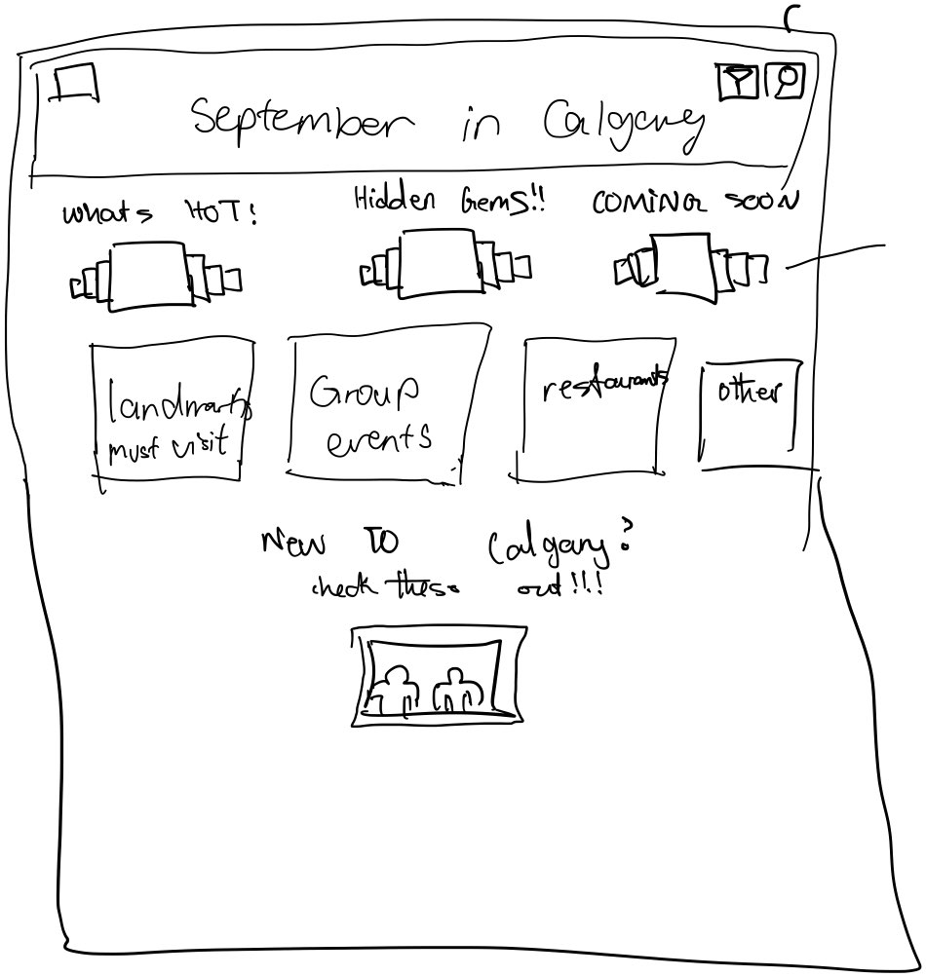
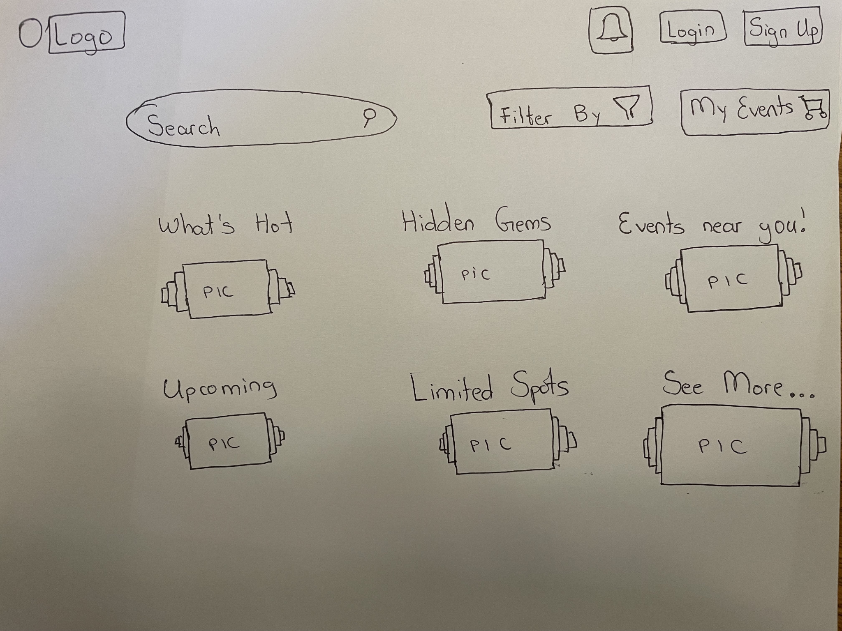
Prototypes (Early Sketches) - Main Page

Slide 6
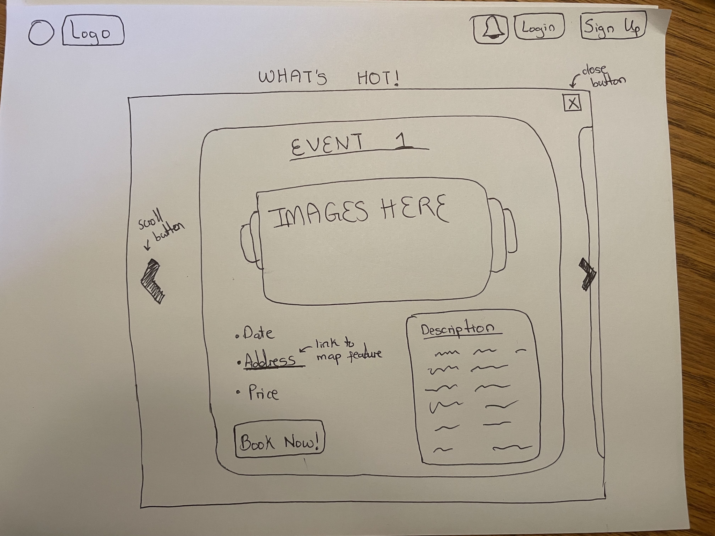
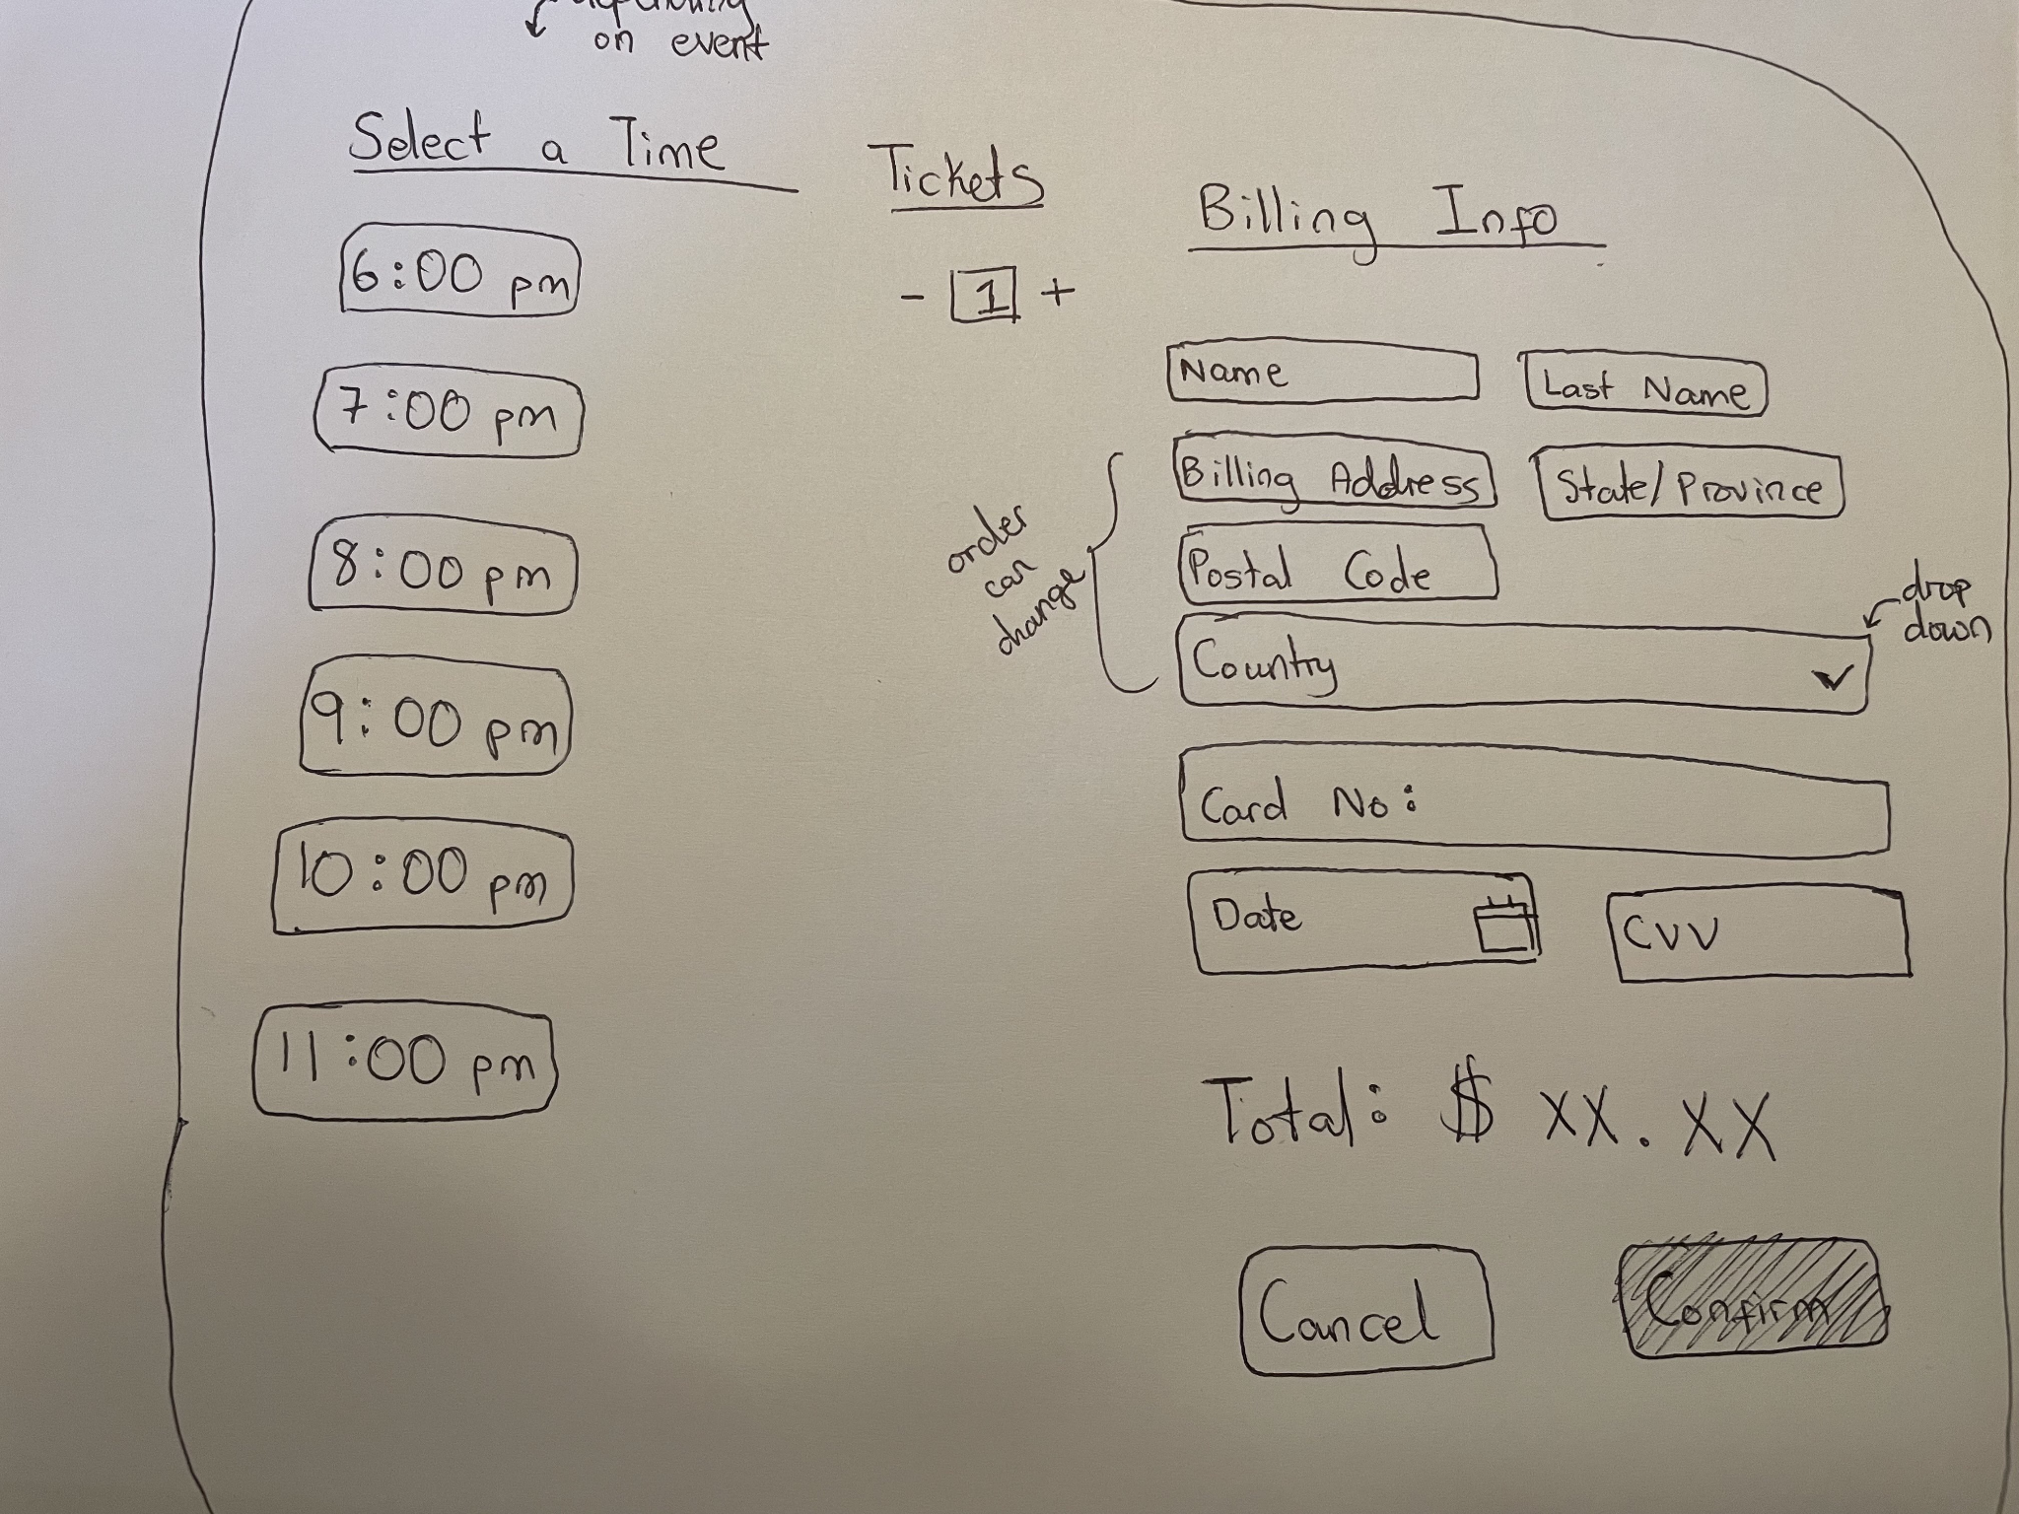
Prototypes (Early Sketches) - Event booking

Slide 7
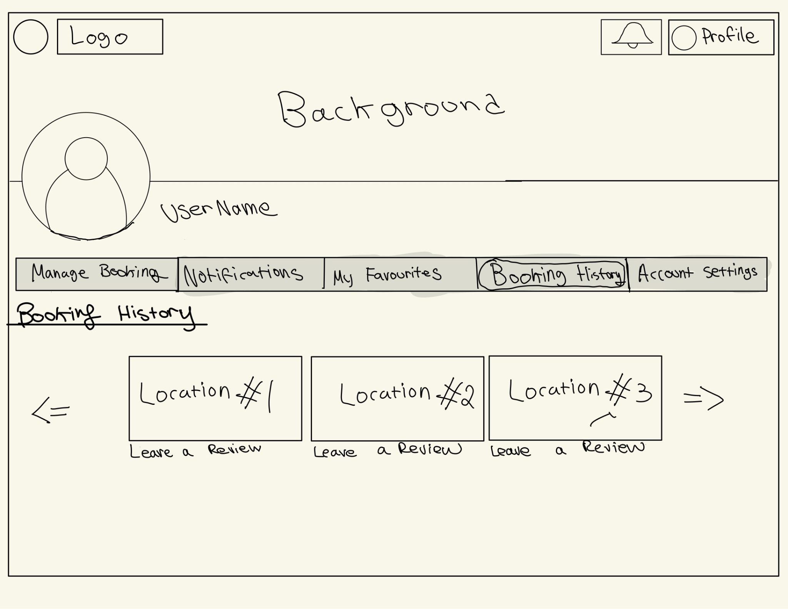
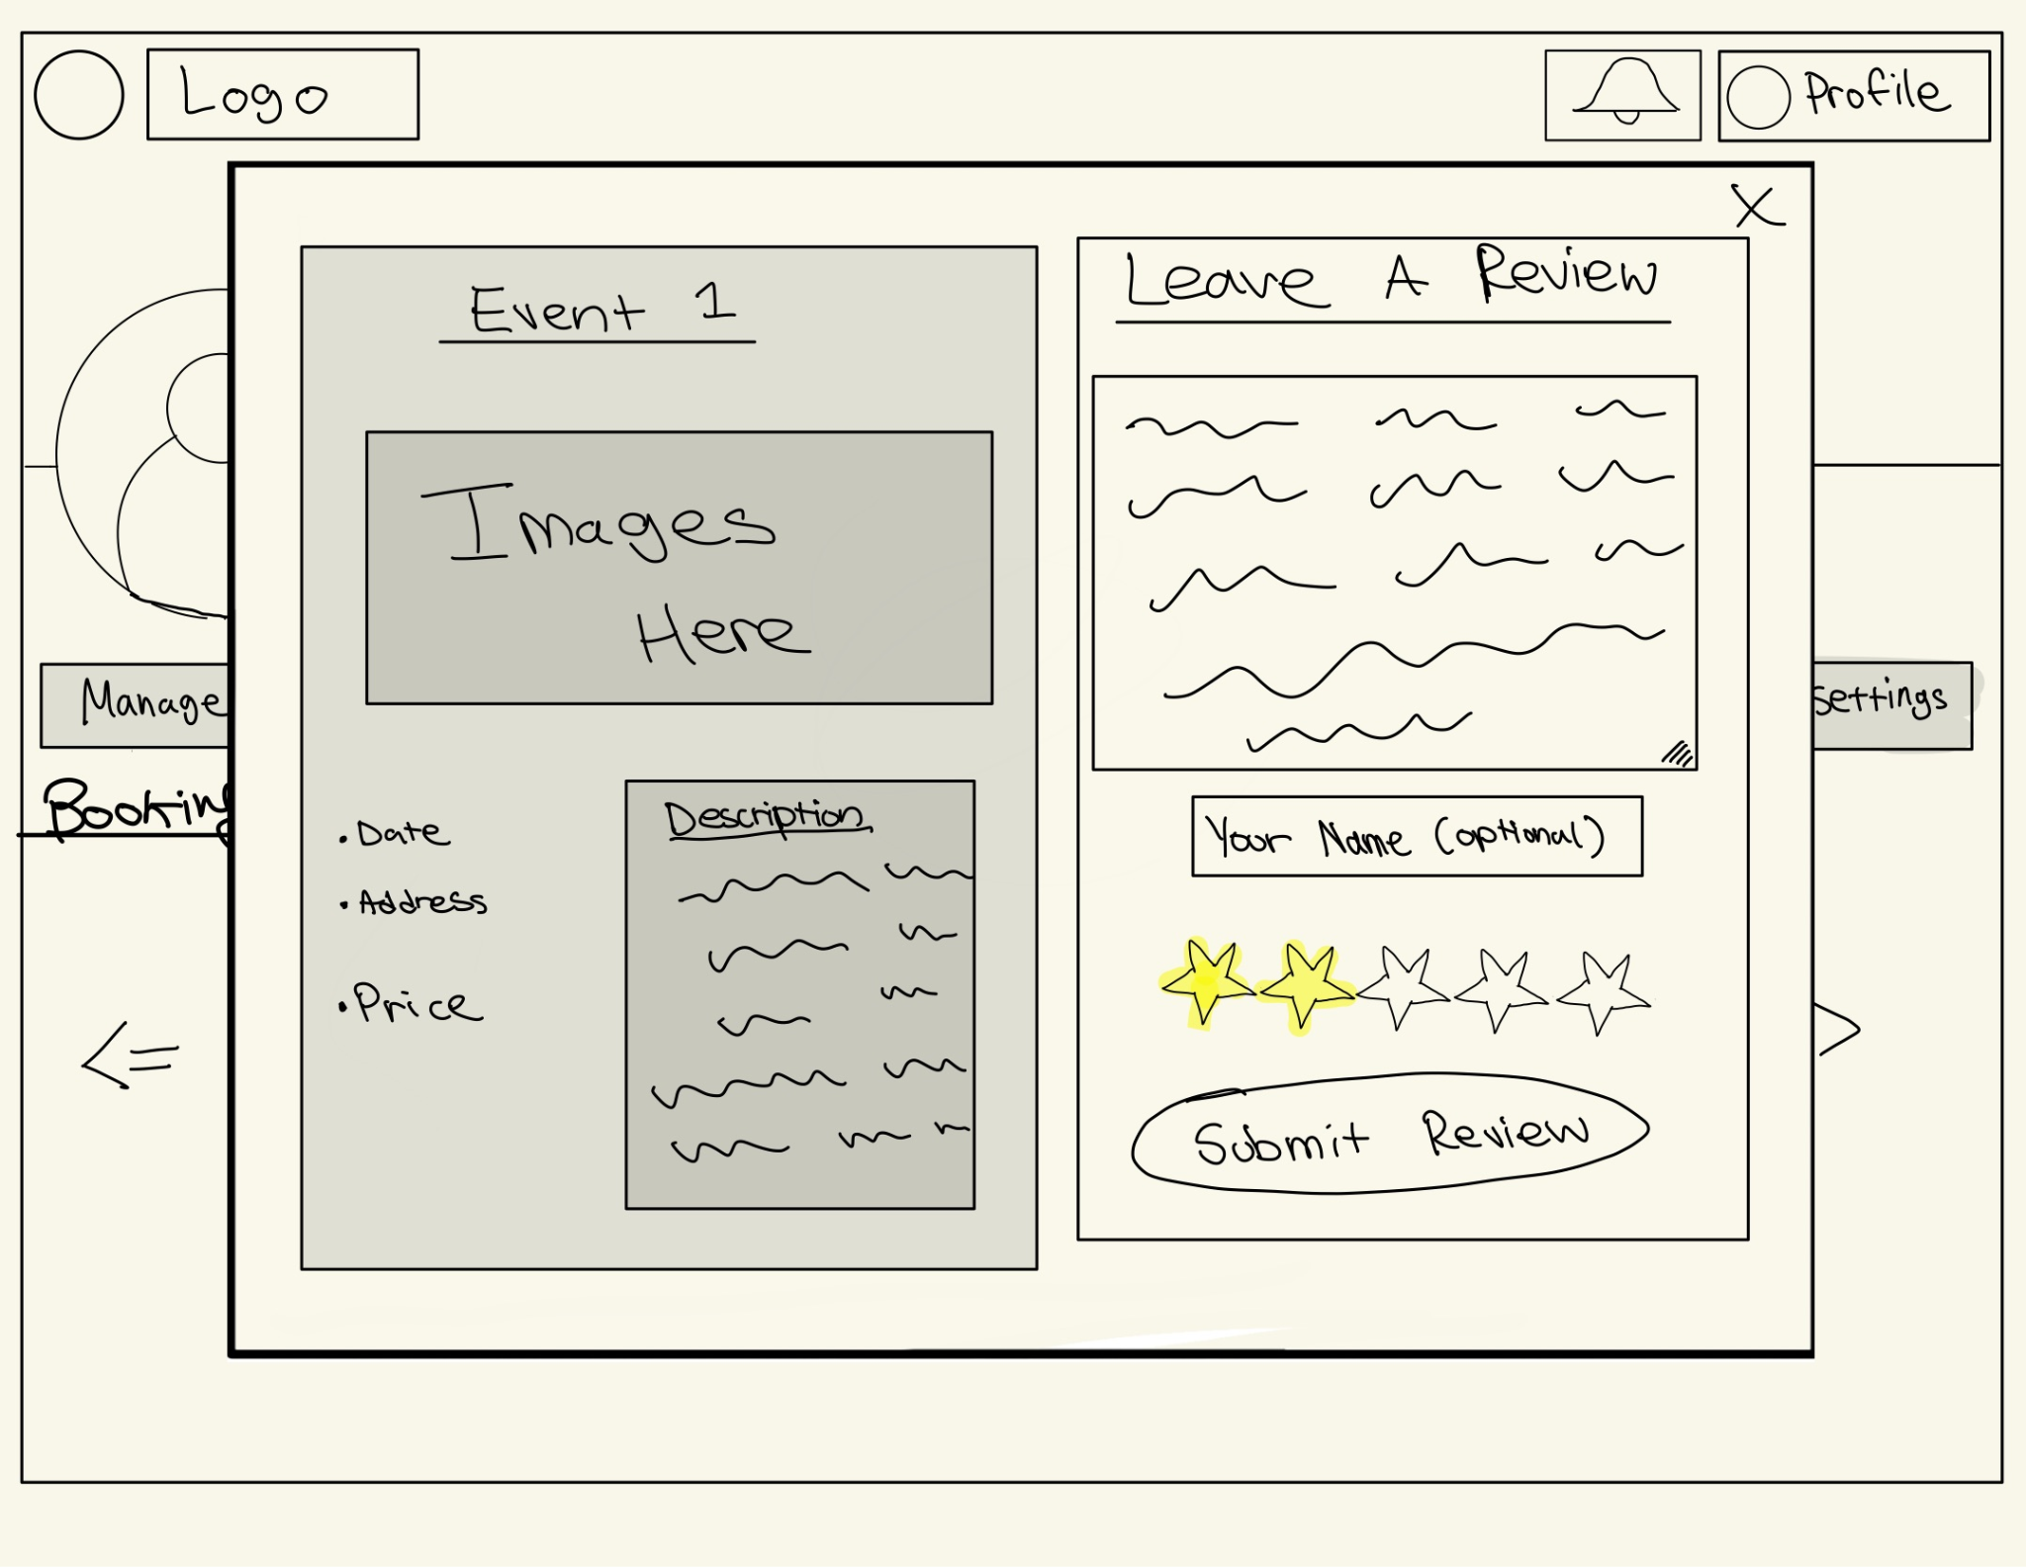
Prototypes (Early Sketches) - Itinerary, Leave review

Slide 8
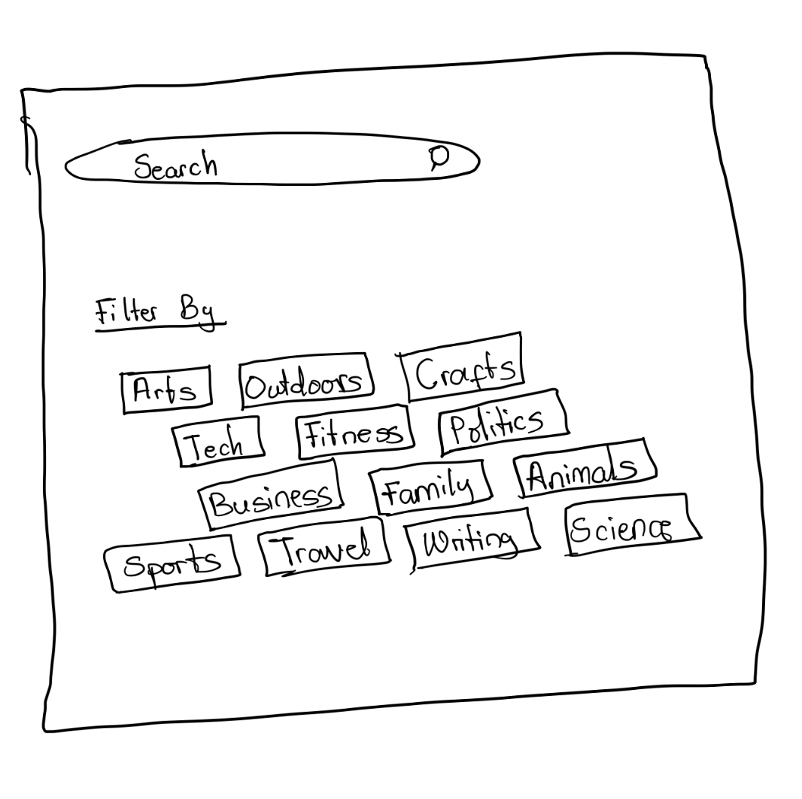
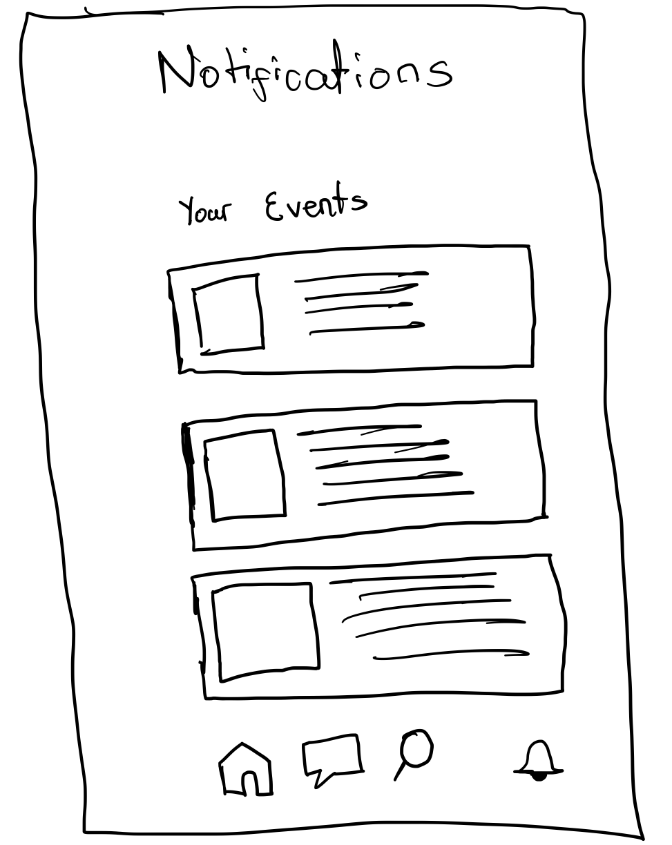
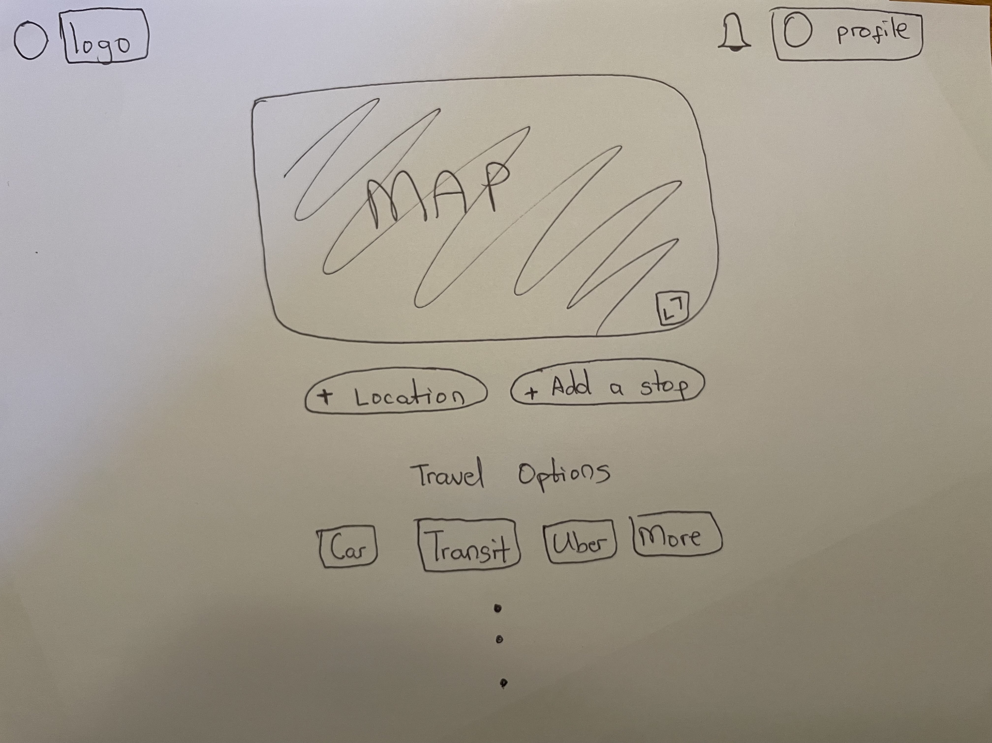
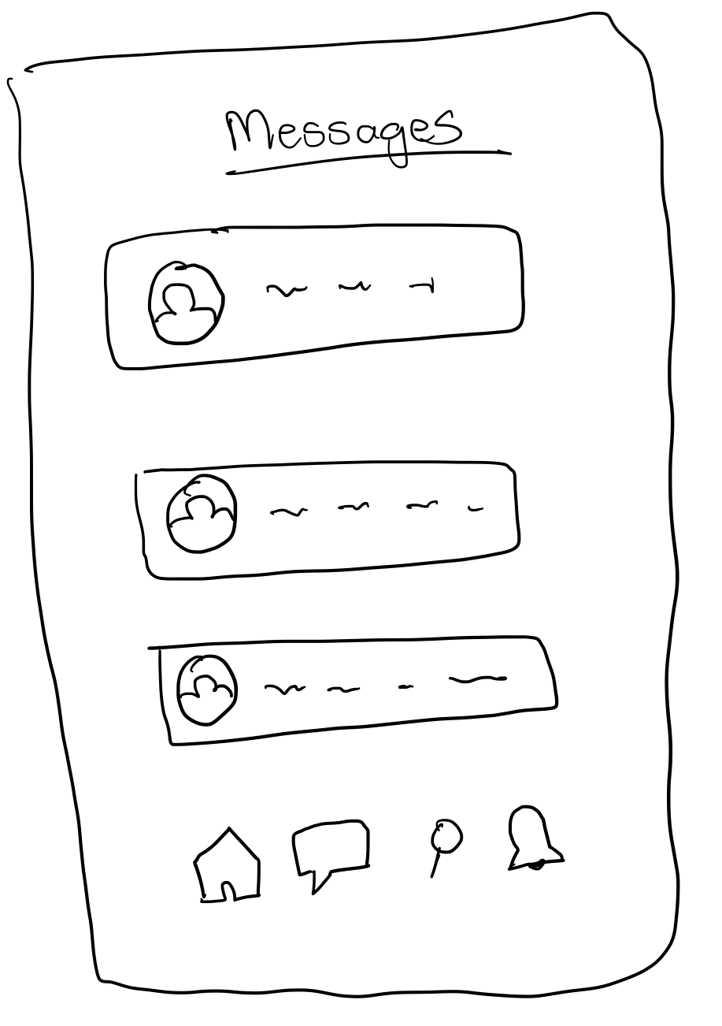
Prototypes (Early Sketches) - Other Features

Slide 9
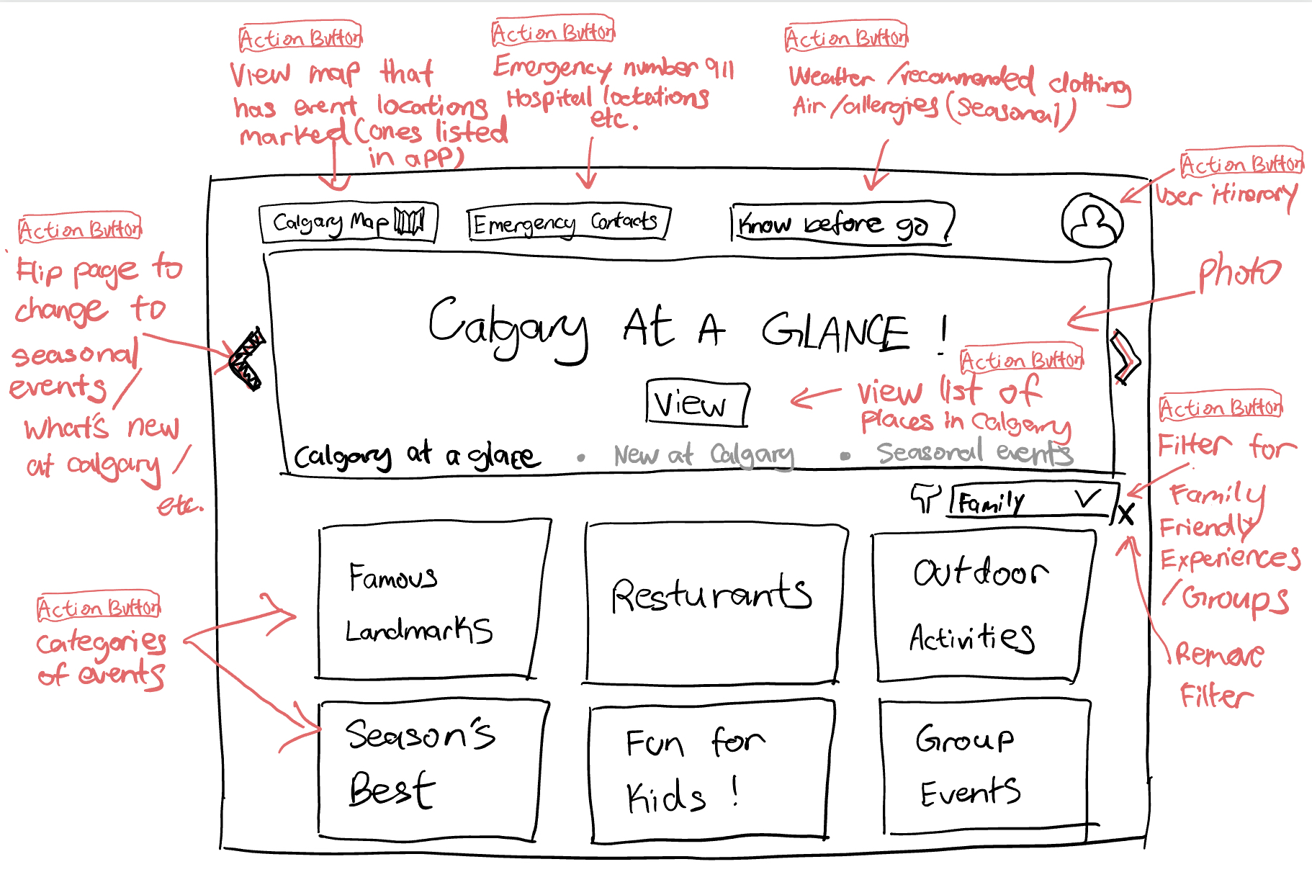
Final Prototype
Profile button
Top Button 1
Top Button 2
Top Button 3
Banner Button 1
Filter Button
Event button 1
Event button 2
Event button 3
Event button 4
Event button 5
Event button 6

Slide 10
Scenarios and Walkthroughs

Slide 11
Task recap
Henry, 30, is planning a five-day trip to Calgary this spring. He starts by googling “top calgary attractions” and clicks into some travel blogs, forums, tour guide ads and notes down a few attractions that interest him(Calgary Tower, Calgary Zoo, etc.). Next, he conducts more detailed searches for these attractions.
He googles “Calgary Tower” and gathers basic information about it such as location, price, and opening times. He does so for a couple of attractions he previously noted down. After gathering enough information, he now decides to visit an attraction(Calgary Tower).
He searches for Calgary tower again in google and tries to find sites that sell tickets to Calgary Tower. He compares the official site with other travel booking websites and decides to go with official site. He books a ticket in the official site and notes down the date, time, location, etc. to his itinerary. He repeats this step a couple times for his other attractions. As he continues his research, Henry frequently revises his itinerary, adding or removing locations based on how much time he estimates for each activity.
Issues for task
Tedious manual information gathering because of scattered research sources
Lack of seamless integration
Frequent revising of the itinerary

Slide 12
Scenario
Henry, 30, is planning a five-day trip to Calgary this spring. He opens the travel app and notices “Calgary at a glance” banner and clicks “view”. He sees a list of attractions Calgary has to offer and clicks into Calgary tower. He views the details of this attraction and finds it interesting.
He returns back to the list of attractions and clicks into another attraction to view details. He repeats this couple times looking at various attractions. He wonders where each location is located in Calgary. So he returns to main menu hoping to find a map somewhere. He finds “Calgary map” button at top left corner and clicks into it. He checks the location of each attraction and gets a better understanding of the city.
He then decides to click back into Calgary tower and tries to book a ticket. He selects date and time and one ticket. Then he proceeds to payment. He pays and booking is confirmed. He clicks the button that appears which leads him to his personal itinerary page. He sees his booking there.
He returns back to main page to find some other attractions to book tickets to and repeats the above booking process a couple times. He returns to his itinerary and double checks the details of his various bookings. He saves a pdf copy of his itinerary.

Slide 13
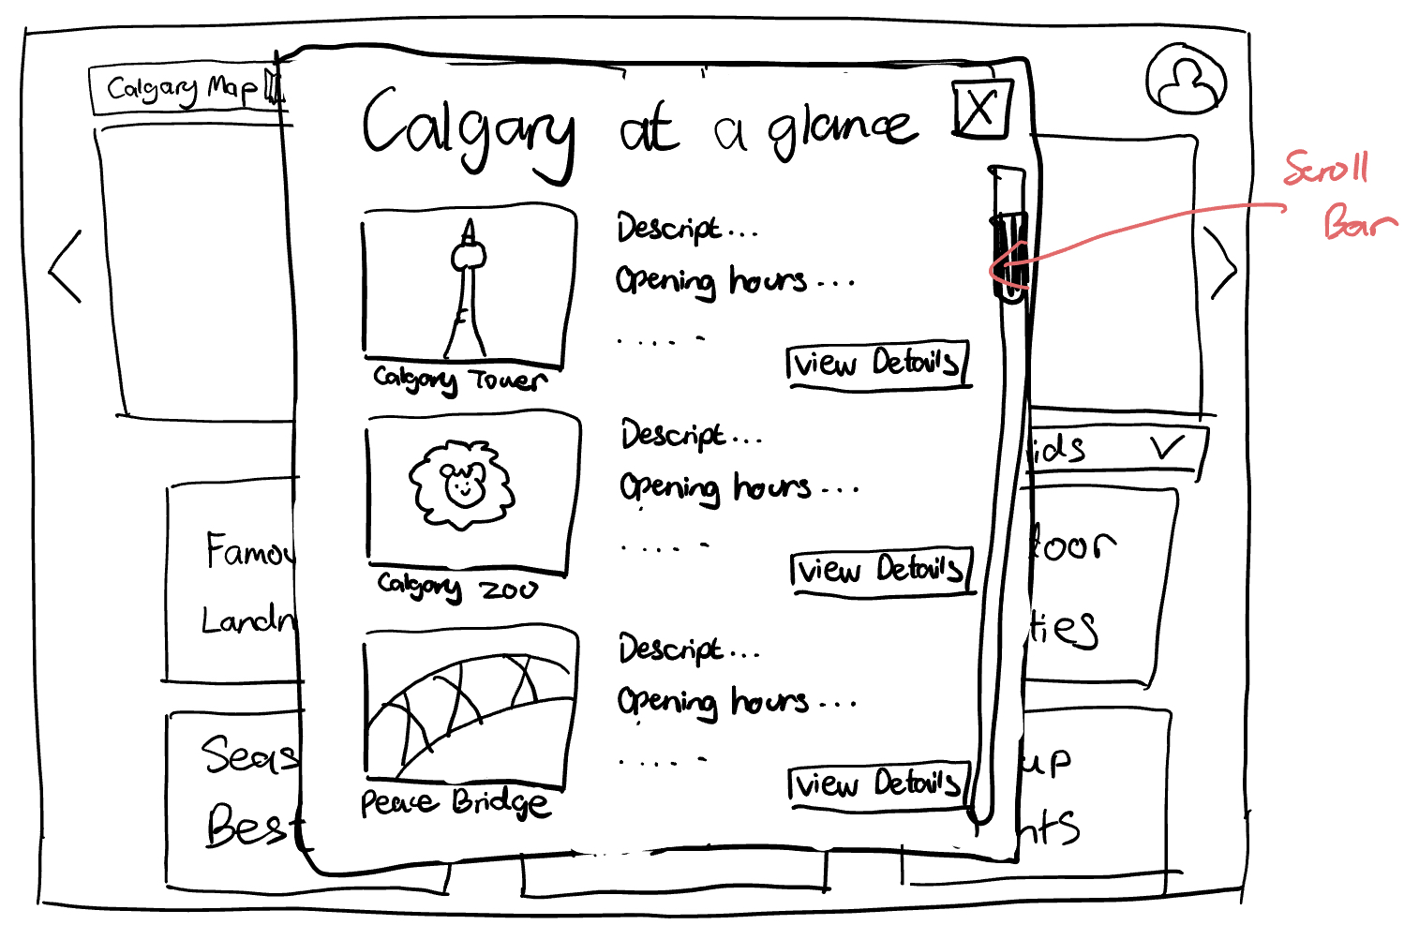
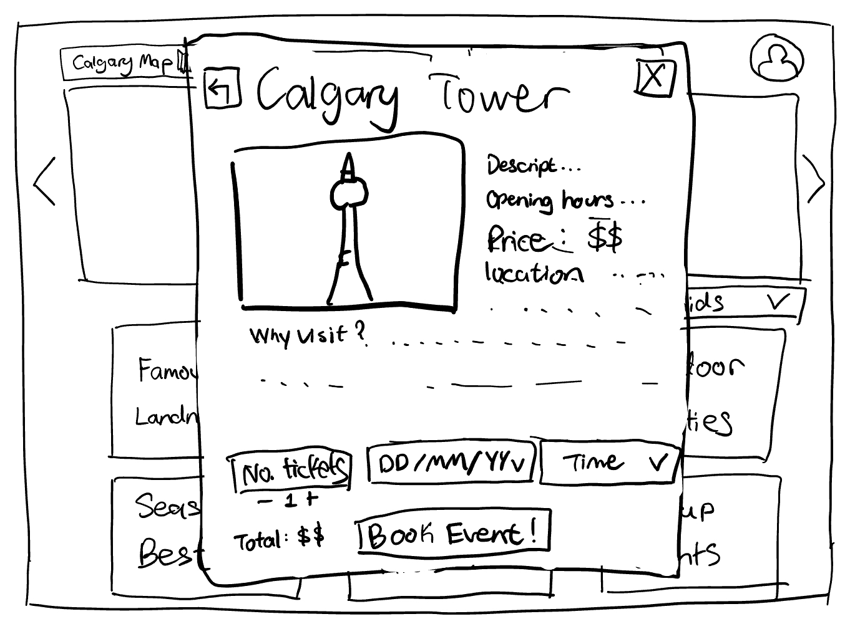
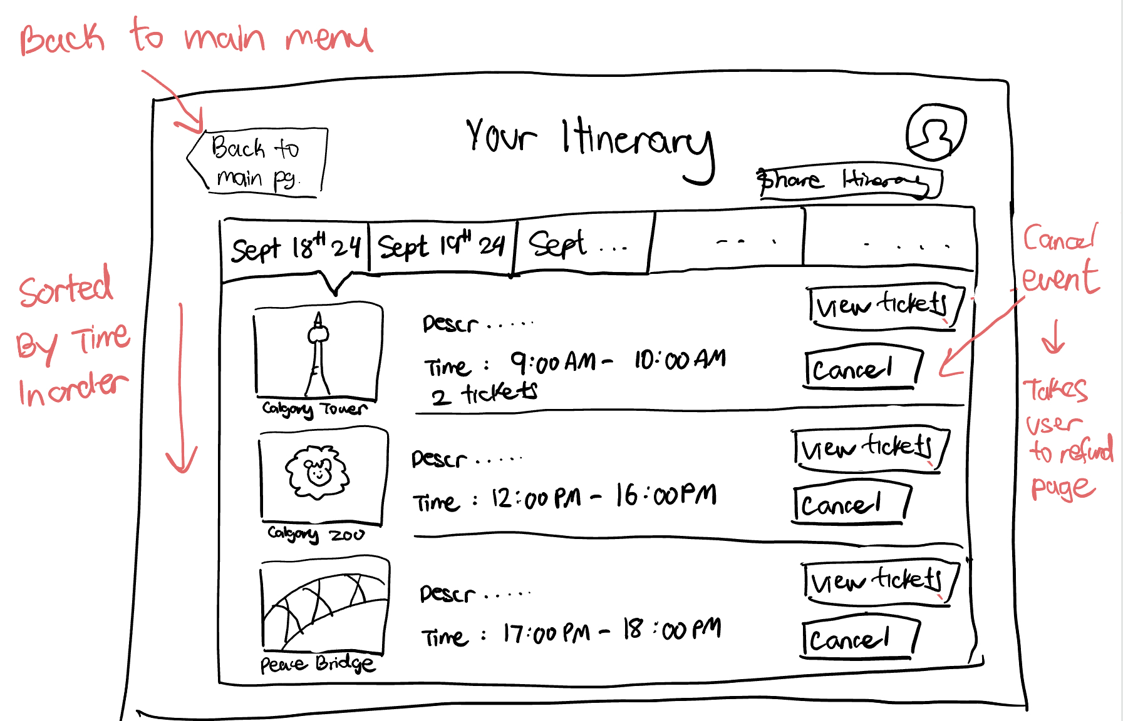
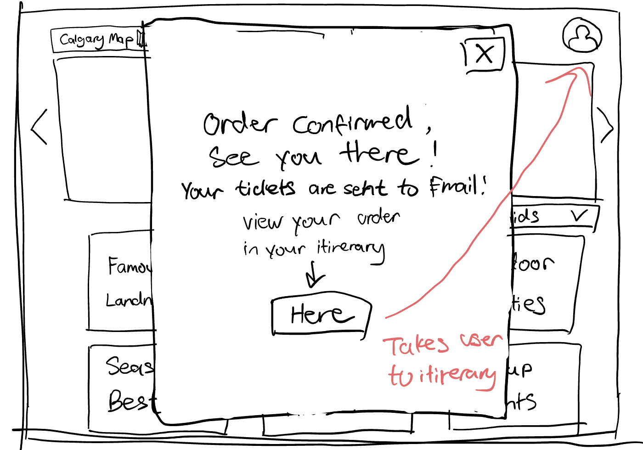
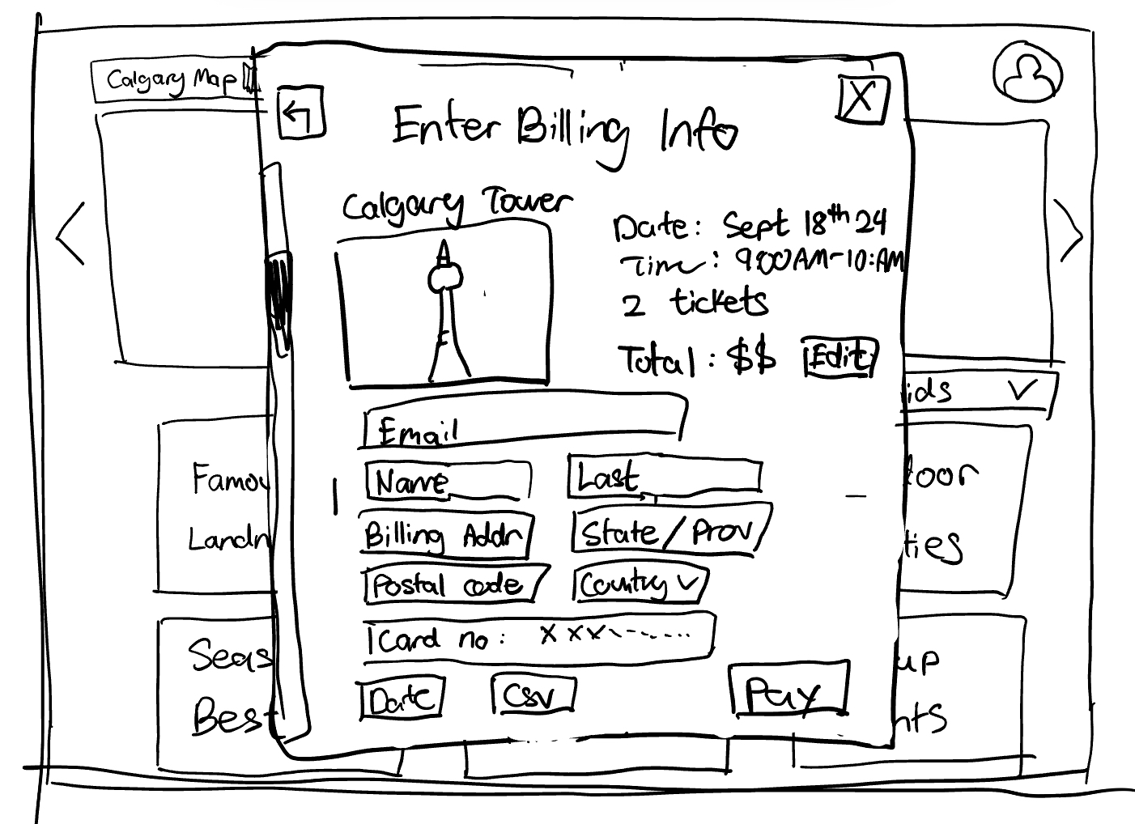

Slide 14
Walkthroughs
Step 1
User sees banner “Calgary At A Glance” and clicks Banner Button 1. Motivated? Knowledgeable?
User might not understand what “View” button might show them. User might be worried that they get redirected to another page.
Comments
Maybe add some prompt letting user know what to expect. (Ex. click here for a quick view of main attractions)
Profile button
Top Button 1
Top Button 2
Top Button 3
Banner Button 1
Filter Button
Event button 1
Event button 2
Event button 3
Event button 4
Event button 5
Event button 6

Slide 15
Walkthroughs
Step 2
User views the list of famous Calgary landmarks and clicks Detail Button 1 Motivated? Knowledgeable?
User might want to scroll and view multiple attractions before viewing details. Not motivated at this point to view details.
Comments
Add more flippable preview images for each attraction to make users more interested in seeing more details.
Detail Button 1
Detail Button 2
Detail Button 3

Slide 16
Walkthroughs
Step 3
User views attraction details and clicks return button to see more attractions. Motivated? Knowledgeable?
May not be obvious to user that this button takes them back to the list of attractions(previously viewed)
Comments
Change arrow to text prompt? (Ex. Return to list)
Return button
Close button
Minus button
Add button
Dropdown 2
Dropdown 3
Field 1
Field 2
Field 3
Book Button
Field 4

Slide 17
Walkthroughs
Step 4
User scrolls through attractions and clicks Close Button Motivated? Knowledgeable?
Yes, the close button should be obvious.
Comments
Maybe also allow users to click outside of pop up to close it.
Close button
Detail Button 1
Detail Button 2
Detail Button 3

Slide 18
Walkthroughs
Step 5
User gets back to main page and clicks Top Button 1 to view maps. Motivated? Knowledgeable?
Button might not be visible to users. (Placement issue?)No clear instructions on what happens after clicked. (Does it redirect? Is it pdf? What does the map have?)
Comments
Place the button somewhere more visible. Hover prompt to inform user of what the map is?
Profile button
Top Button 1
Top Button 2
Top Button 3
Banner Button 1
Filter Button
Event button 1
Event button 2
Event button 3
Event button 4
Event button 5
Event button 6

Slide 19
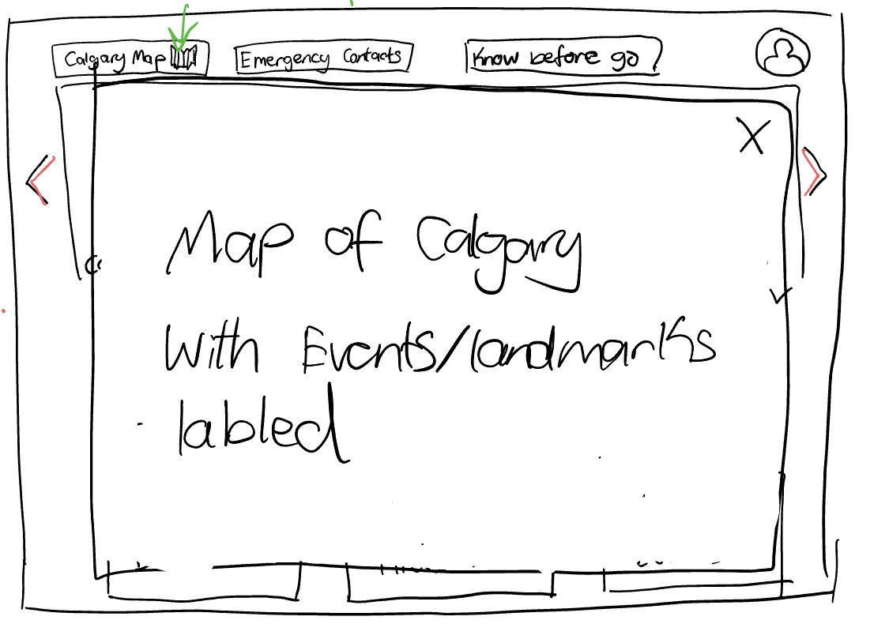
Walkthroughs
Step 5
User views map that is a static zoomable image of map of Calgary, with famous attractions labeled. And clicks Close Button. Motivated? Knowledgeable?
Yes, the close button should be obvious.
Comments
Maybe also allow users to click outside of pop up to close it.
Close button

Slide 20
Walkthroughs
Step 6
User returns to main page, and clicks into “Calgary at a glance” Banner Button 1. To view list of attractions again.
Motivated? Knowledgeable?
Yes, user has done it before.
Comments
N/A
Profile button
Top Button 1
Top Button 2
Top Button 3
Banner Button 1
Filter Button
Event button 1
Event button 2
Event button 3
Event button 4
Event button 5
Event button 6

Slide 21
Walkthroughs
Step 7
User clicks Detail Button 1 again, this time to book an event. Motivated? Knowledgeable?
Yes, user has done it before.
Comments
N/A
Close button
Detail Button 1

Slide 22
Walkthroughs
Step 8
User views more detailed descriptions and clicks date drop down to select a date. Field 2 updates to date selected. (User does not click on add or minus button because default is 1 and user travels alone) Motivated? Knowledgeable?
Not obvious to users that it is clickable.
Comments
Make it more obvious that it is an action item(add arrows/ prompts?)
Close button
Minus button
Add button
Dropdown 2
Dropdown 3
Field 1
Field 2
Field 3
Book Button
Field 4

Slide 23
Walkthroughs
Step 9
User clicks Dropdown 3 to select an available time to visit. Field 3 updates to time selected.
Motivated? Knowledgeable?
Not obvious to users that it is clickable.
Comments
Make it more obvious that it is an action item(add arrows/ prompts?)
Close button
Minus button
Add button
Dropdown 2
Dropdown 3
Field 1
Field 2
Field 3
Book Button
Field 4

Slide 24
Walkthroughs
Step 10
User clicks Book Button to book event.
Motivated? Knowledgeable?
Not obvious to users what happens next.
Comments
Make it more obvious that it takes to booking confirmation and payment(if needed).
Close button
Minus button
Add button
Dropdown 2
Dropdown 3
Field 1
Field 2
Field 3
Book Button
Field 4

Slide 25
Walkthroughs
Step 11
User double checks the booking details, and fills in information in Enter fields for email and billing address. Motivated? Knowledgeable?
The user may not understand why they need to fill in email(its for sending confirmation and tickets).
Comments
Add prompts explaining why these info is needed.
Close button
Edit Button
Enter fields
Pay Button

Slide 26
Walkthroughs
Step 12
User wants to view the confirmed booking, so he clicks Redirect Button.
Motivated? Knowledgeable?
User might not understand whether clicking this button is a MUST. And if they can do it later.
Comments
Let user know with prompts that they can either click redirect button or close popup and click profile button later. (both goes to same page)
Close button
Redirect button

Slide 27
Walkthroughs
Step 13
User clicks Ticket button 1 to view ticket details. Motivated? Knowledgeable?
Might not be obvious to users what this action would show them, would it redirect or would it download ticket?
Comments
The tickets would be opened in a preview pop up with option to download. And we need to make it obvious to user by adding prompts.
Ticket button 1

Slide 28
Walkthroughs
Summarize the key issues with that walkthrough
User might not be motivated to do all the actions (Add more prompts and engage users)
some action buttons have unclear instructions (Add more obvious instructions and inform user of action results)
Users might not be able to find what their looking for when they use the app for the first time. (Better placement of buttons)

Slide 29
Walkthroughs
Task was originally done very tediously
Tedious manual information gathering because of scattered research sources
Lack of seamless integration
Frequent revising of the itinerary
Our Scenario is much more efficient and user friendly
Lets users accomplish the same goal while staying in one app
Able to view/book/build itinerary all in our system
Easy to use and requires minimal knowledge of travel planning

